Slide 1
Understanding of 3D-Var And Cloud Detection

Slide 2



Analysis: Why we do assimilation? Background: Observation:

Slide 3

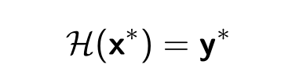


Perfect Observation Operater:
Then,we have:

Slide 4




For any
Next : Describe the analysis errors

Slide 5
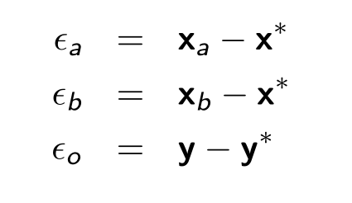



Slide 6


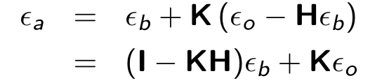
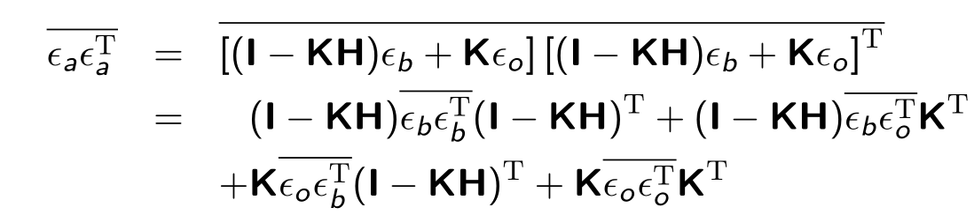
Assuming that:
How to assess that the analysis is good? minimum variances

Slide 7

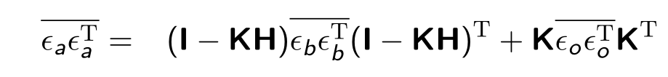
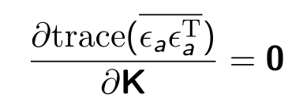
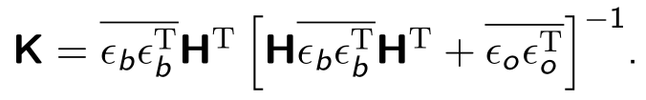
Assuming that:

Slide 8




Then:
Existing Problem: Estimate Background Error、artifacts
Next : From Bayes’ theorem to 3D-Var

Slide 9
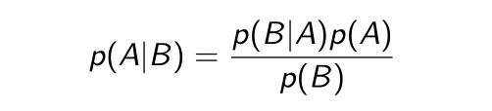

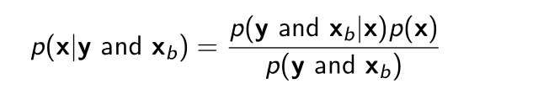



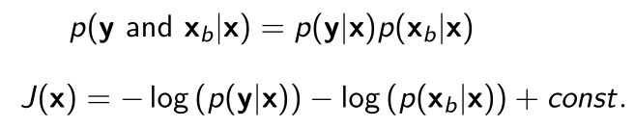

Slide 10
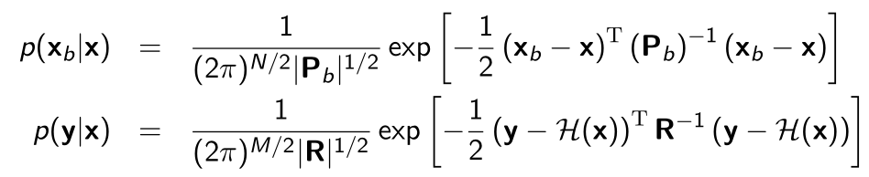

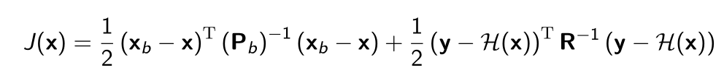


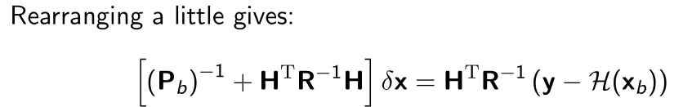
Same as the Optimal Interpolation

Slide 11







Solution to minimize the cost function:
Newtons Method：
Steepest descent：

Slide 12
Cloud Detection： 晴空通道云检测：依赖背景误差协方差 成像仪云检测:舍弃资料多 成像仪+晴空通道云检测 Logistic Regression:准确率更高

